Slide 1
SPORT CENTER APPLICATION
Mergea Sergiu – OCTAVIAN 4.2
Neagoe Dan – Petre 4.2

Slide 2
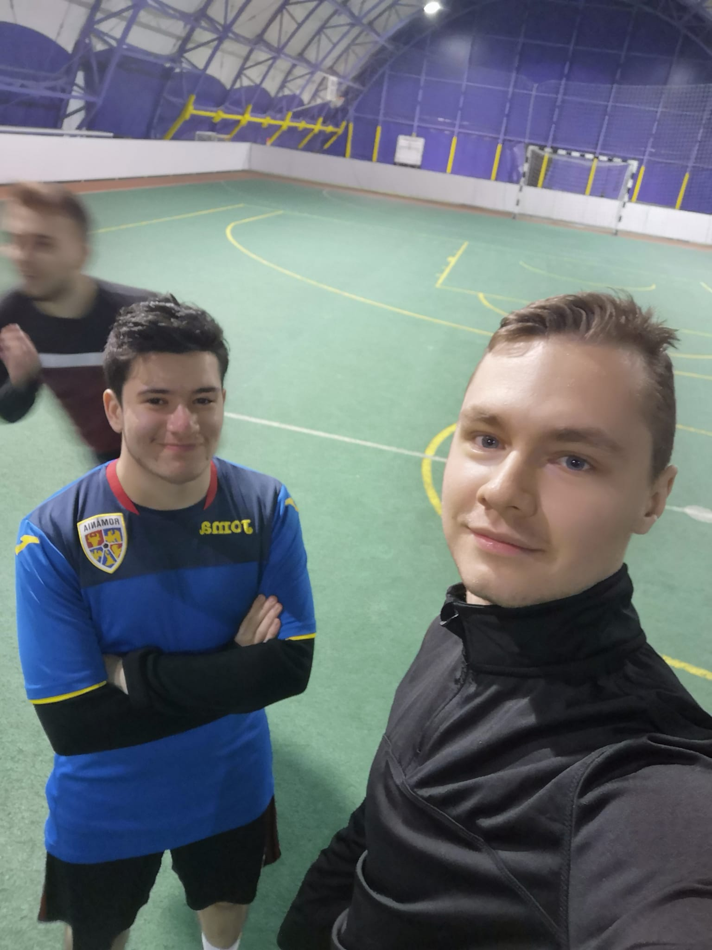
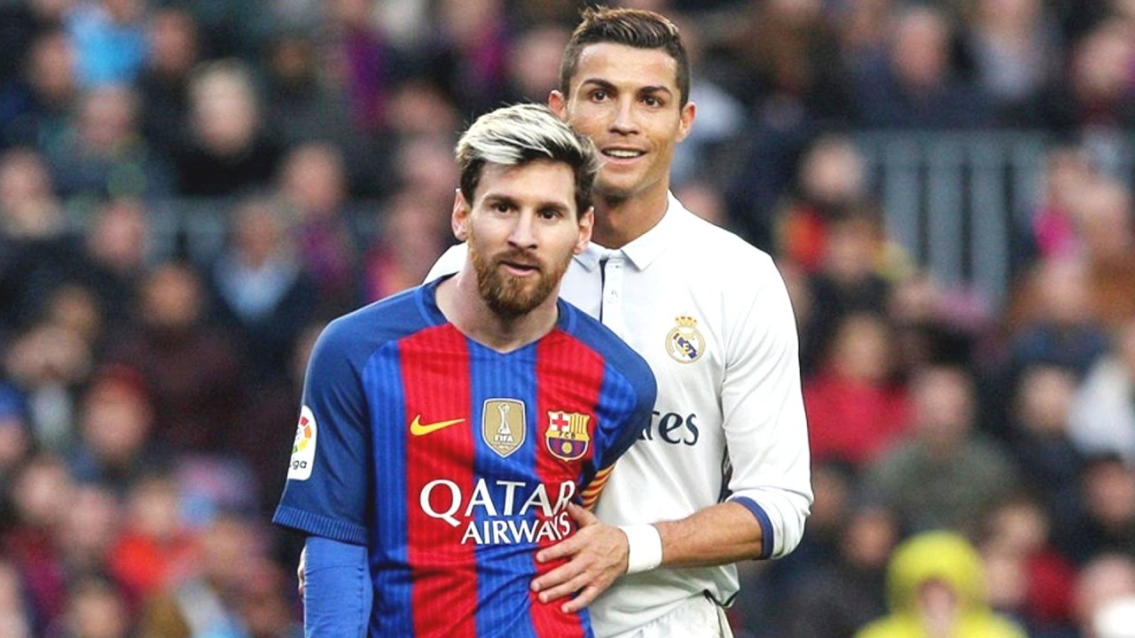
DE CE AM ALES ACEST PROIECT ?...

Slide 3
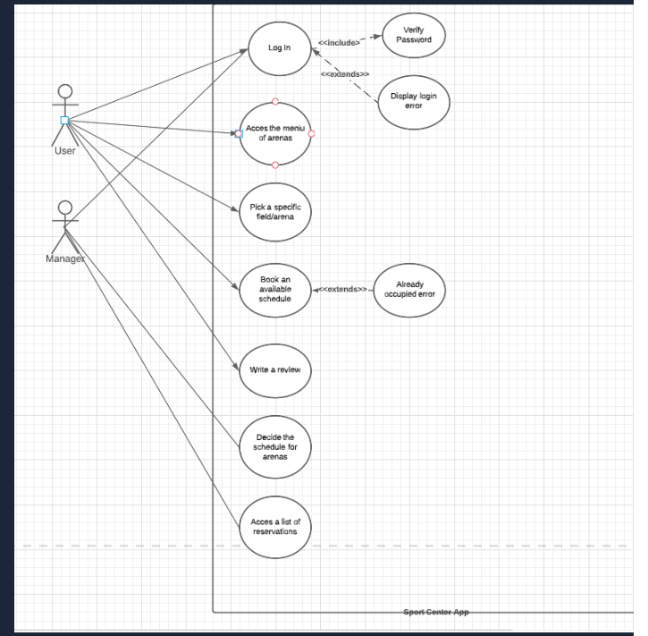
Diagrama use case

Slide 4
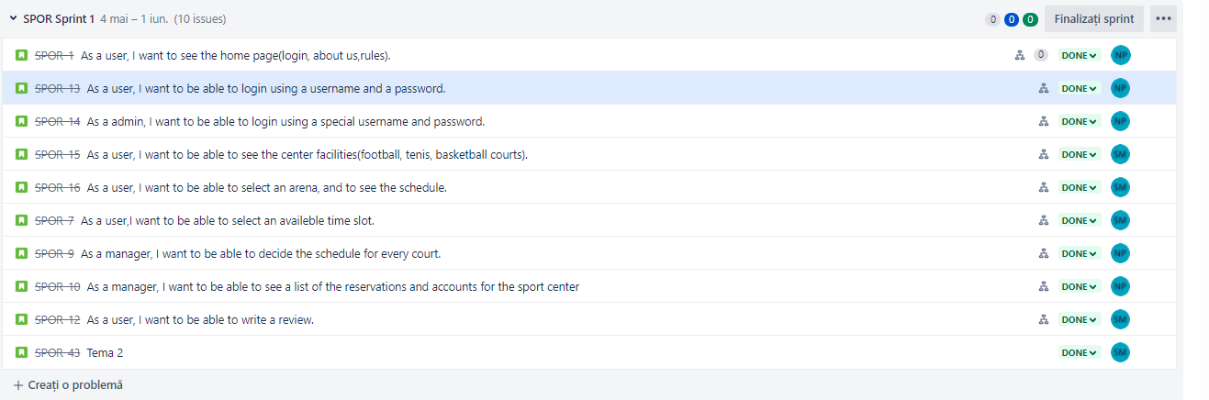
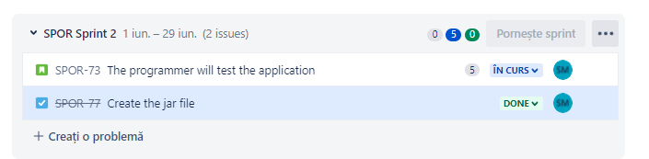
JIRA OVERVIEW

Slide 5
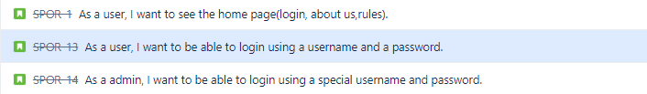
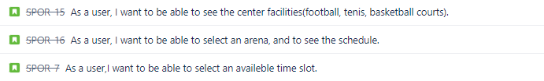
Dan
SERGIU

Slide 6
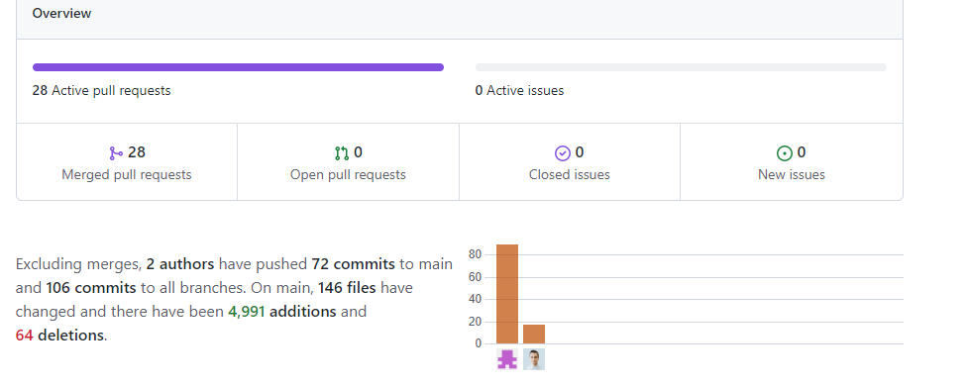
Project overview
MERGEA SERGIU – OCTAVIAN : 89 Commits
NEAGOE DAN – PETRE : 17 Commits

Slide 7
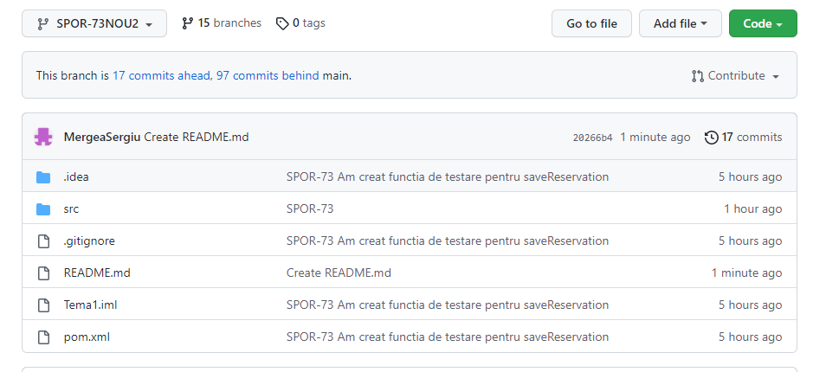
Branches : 15

Slide 8
DEMO

Slide 9
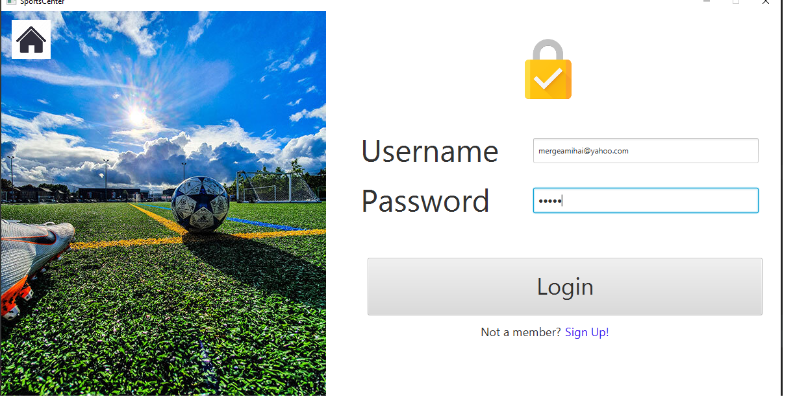
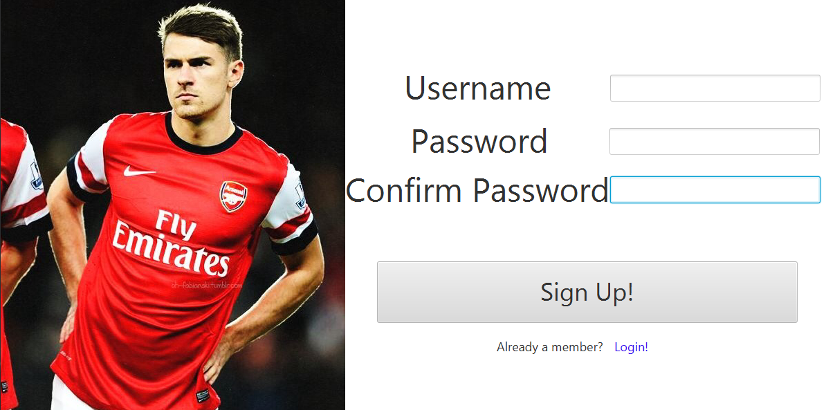
Login SI REGISTER By dan

Slide 10
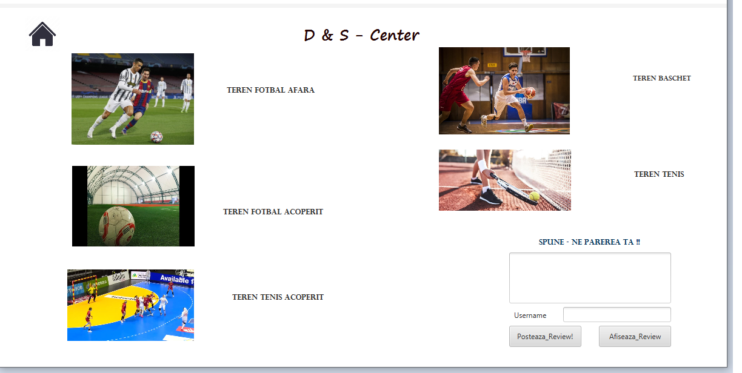
User interface and review section by Sergiu

Slide 11
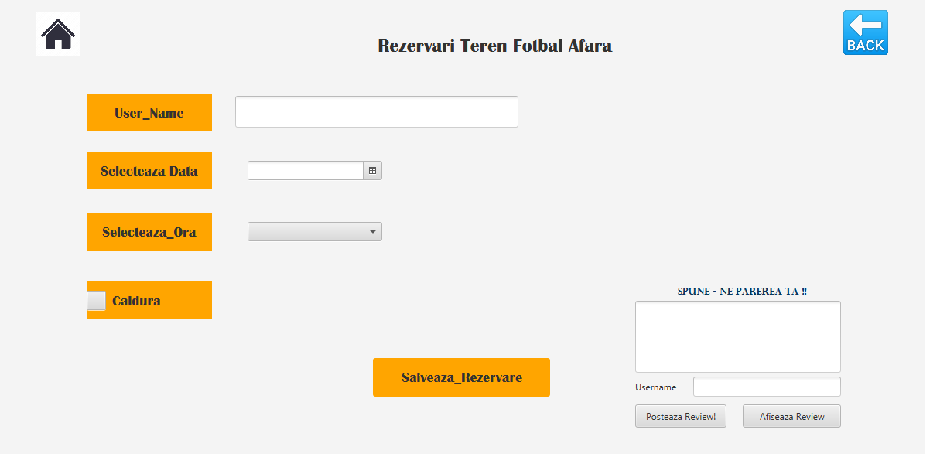
Reservation page by Sergiu

Slide 12
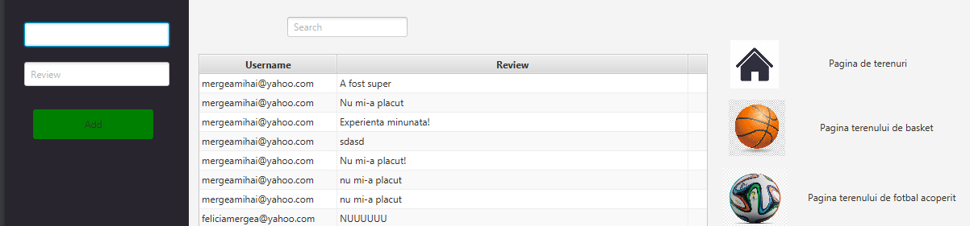
Review page by sergiu

Slide 13
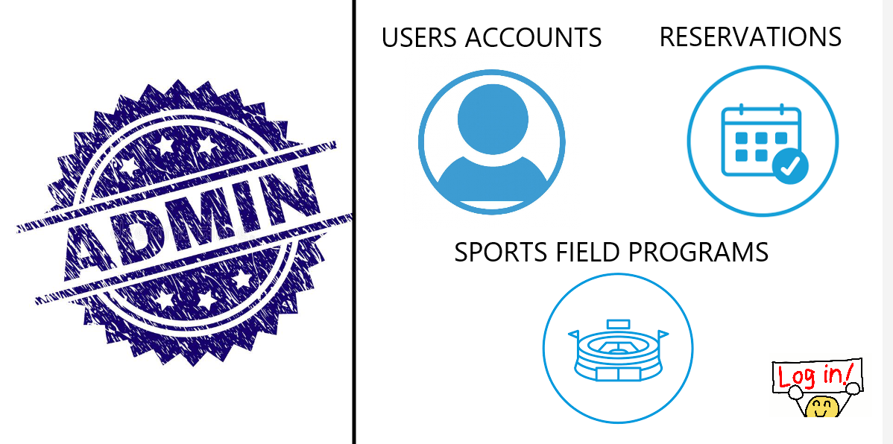
Admin page and option by dan

Slide 14
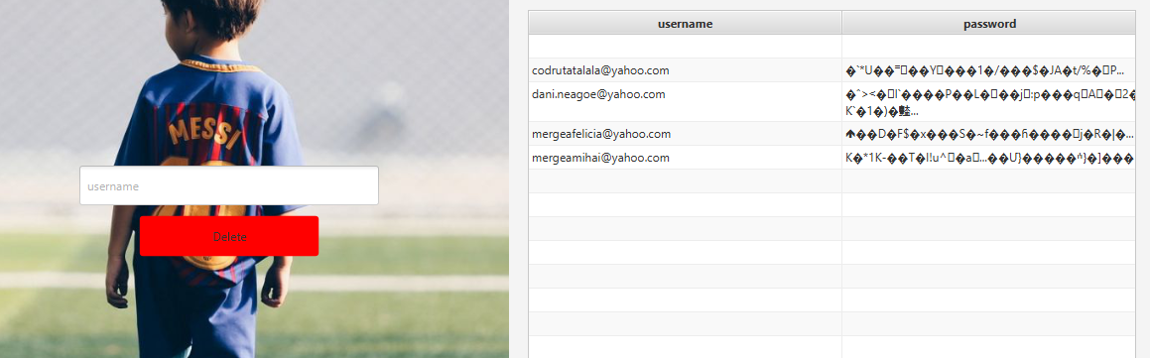
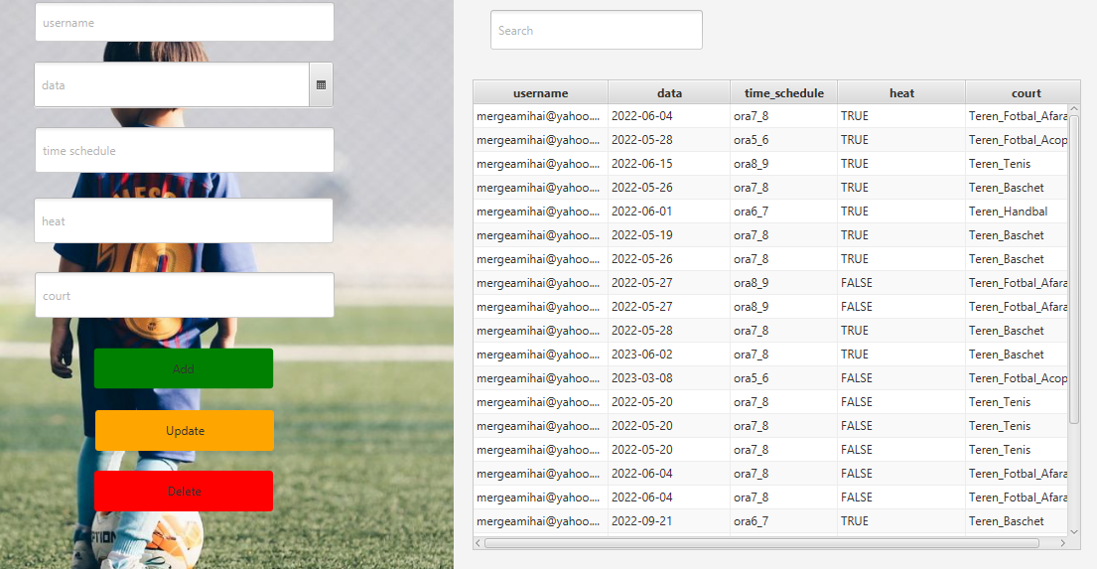
Options for admin by dan
USER LIST
RESERVATION LIST

Slide 15
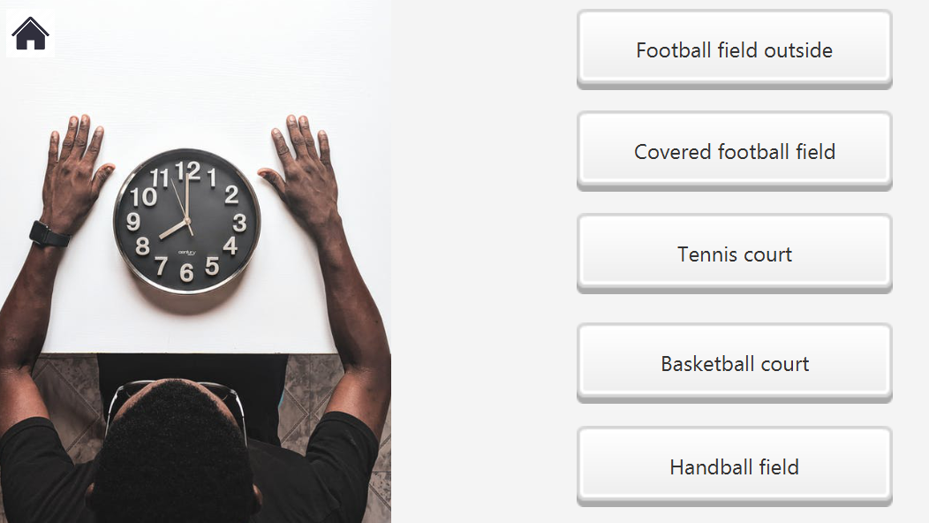
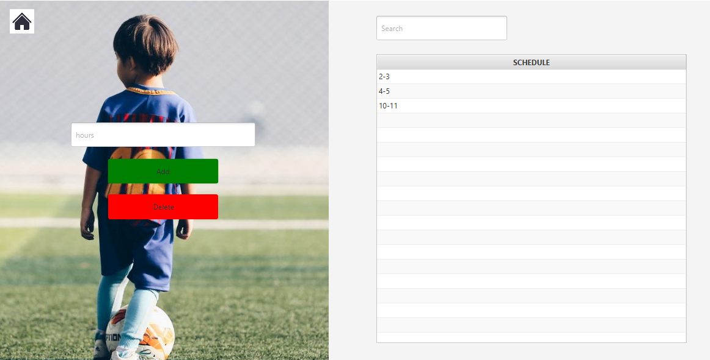
Time schedule option by dan

Slide 16
VA MULTUMIM PENTRU ATENTIE !!!
P.S: GRUPA 4.2 ARE REDUCERE LA BAZA !!!

